Slide 1
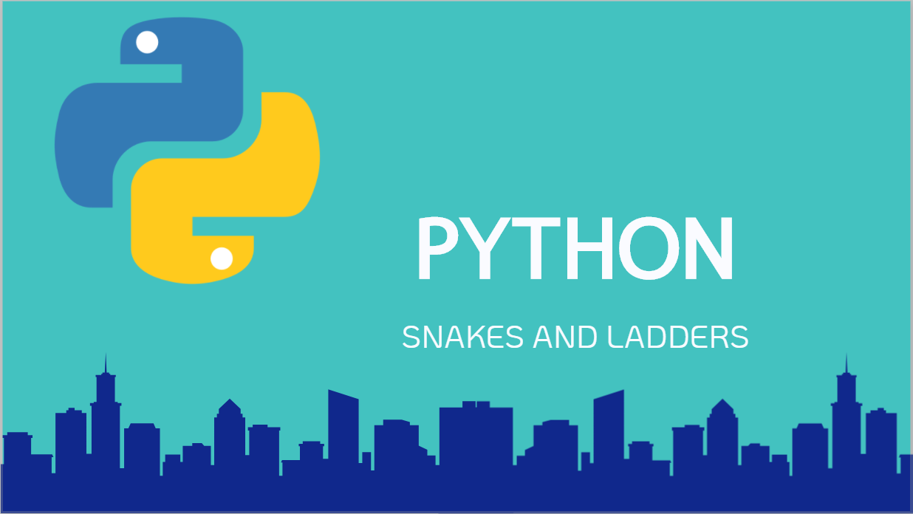

Slide 2
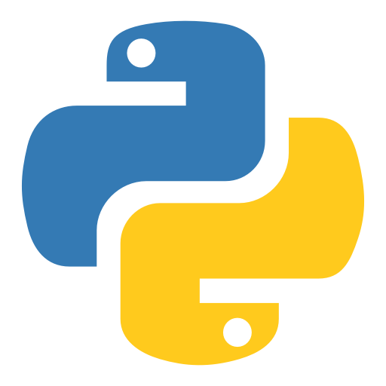
What is Python?
Python is named after the British comedy group Monty Python.
Python is a free, simple and popular programming language used by many industries to create applications, analyse data and web development.

Slide 3




Agenda
The ladder for reaching an understanding for Python
What, Why, Where
Learning what Python is, where its used and why
Careers
Where can Python take you?
Project Python
Discuss a project you’d like to do with Python
Lets Start!
Start using Python and steps to learning more…

Slide 4





Why is Python Popular?
Easy
Free
Flexible
Support
Python was written as an easy to read and write programming language
Python is Open Source and is free to download and use
Python is used for many purposes applications. Desktop, Web and Mobile.
Python has a huge community, all contributing to diverse libraries and support.

Slide 5




Where is Python Used?
Google
To improve search results based on website rankings
NASA
Used extensively for big data and scientific calculations
Python is mostly used for data analysis and scientific calculations, due to its simplistic nature. However, there are many other Python library scripts that have been created that diversifies the uses of Python in industries.
Netflix
To run Machine Learning algorithms to predict user interests

Slide 6
Python Basics
Variables, Data Types, Operators
Arrays
Flow Control
Methods
File Handling
OOPS
Practise Programming

Slide 7

Career Opportunities
Django for Web Development
Pygame for Game Development
AI and Data Science
Big Data
Smart Devices and IOT

Slide 8
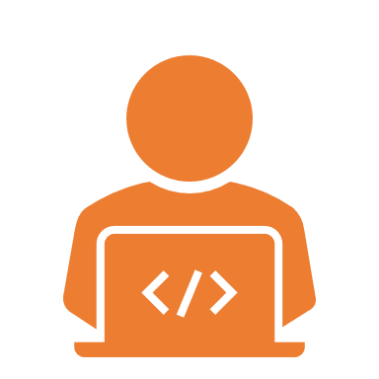


Why do you want to learn Python?
Job
Automation
Upskilling in programming

Slide 9
Lets pick a project
Something you’d like to learn or have a goal in mind
Complexity isn’t important, everything becomes simple in code
Doesn’t matter if its already been made, you still gain experience

Slide 10
Find an Example
Finding a project similar to yours is the easiest way of learning
It doesn’t have to be the same goal, perhaps the same steps

Slide 11
Lets start up Python
Download Python: https://www.python.org/downloads/
IDE vs Text Editor: https://jupyter.org/ or https://code.visualstudio.com/docs/python/python-tutorial

Slide 12

THANK YOU

